Slide 1
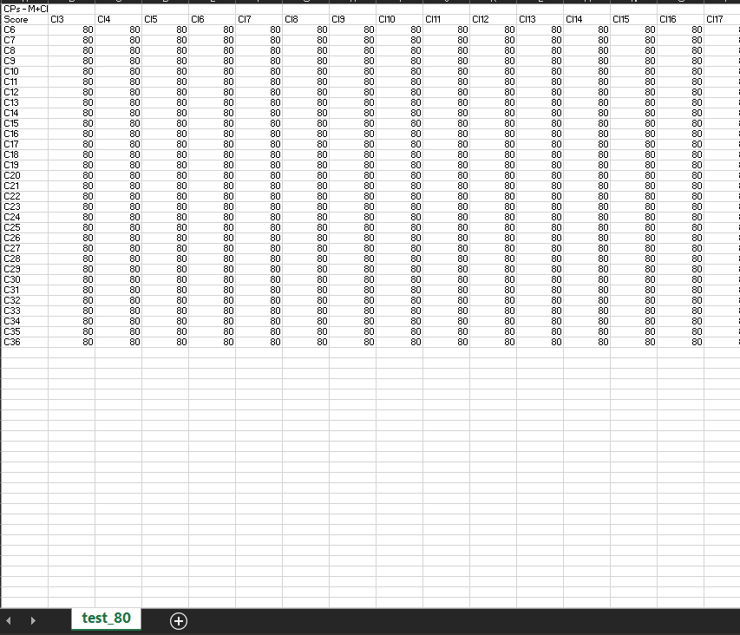
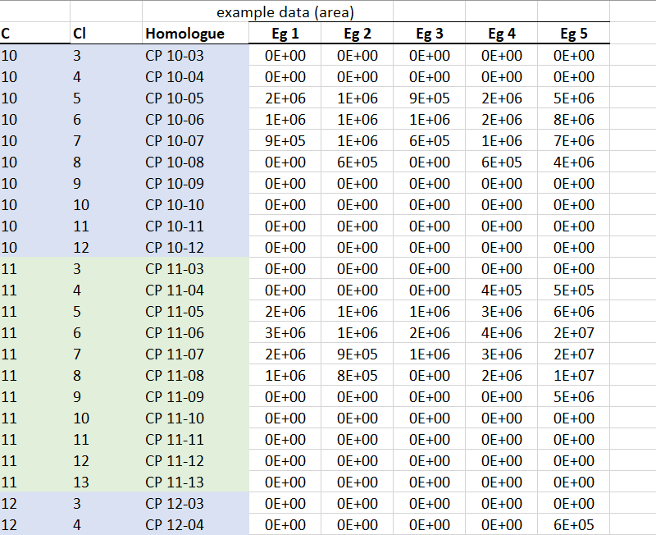
CP-Seeker’s Output
After CP-Seeker Post-Processing App

